Slide 1

Computer Vision Applications
By Quadeer Shaikh

Slide 2

About me
Work Experience
Risk Analyst
Morgan Stanley (Jan 2023 – Present)
Data Science Intern
AkzoNobel Coatings International B.V. Netherlands (Feb 2022 – Dec 2022)
Data Science Intern
EzeRx Health Tech Pvt. Ltd. (Jan 2022 – July 2022)
Associate Engineer
Tata Communications Ltd. (July 2019 – Aug 2020)
Network Automation and Analysis Engineer Intern
Cisco (June 2018 – July 2018)
Education
M.Tech – Artificial Intelligence
NMIMS (2021 - 2023, currently pursuing)
B.E. – Computer Engineering
Mumbai University (2015 - 2019)

Slide 3
Image Operations
Pixel based operations
Contrast Stretching
Thresholding
Inverting/Negative Images
Erosion and Dilation
Bitwise operations, etc.
Regions based operations
Contour Detection
Edge Detection
Line Detection, etc.

Slide 4
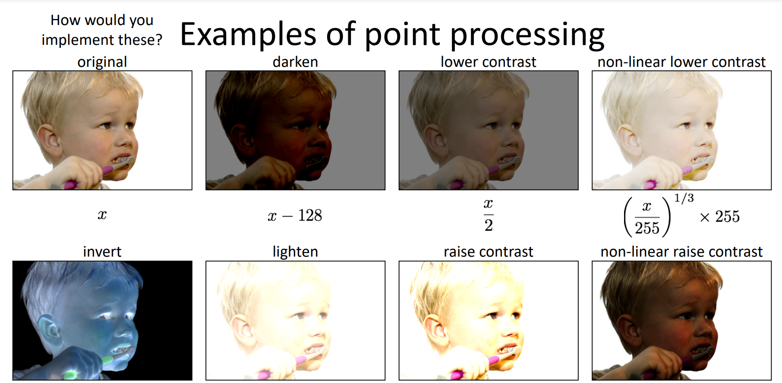
Pixel Based Operations

Slide 5
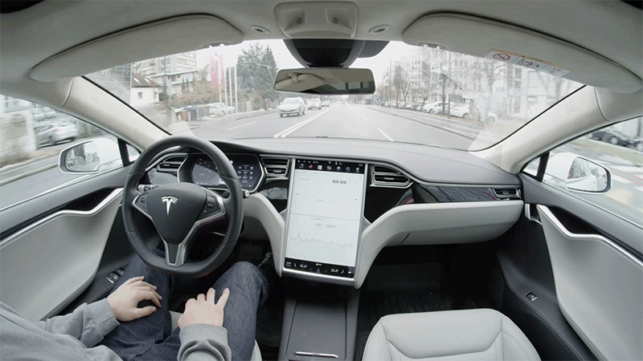
A brief discussion on Self Driving Cars
A self driving car/autonomous car/robotic car is a car that is capable of travelling without human input
Use sensors to perceive their surrounding: optical and thermographic cameras, radar, lidar, ultrasound, GPS, odometry, etc.
Focuses on
Identification of proper navigation paths
Strategies for managing traffic controls and obstacles
Human factors

Slide 6
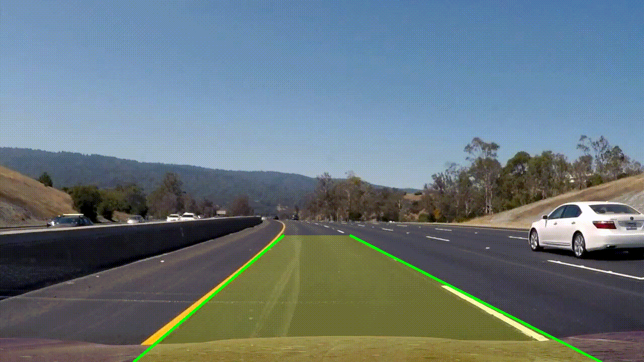
Lane Detection using Edge Detection and Line Detection

Slide 7
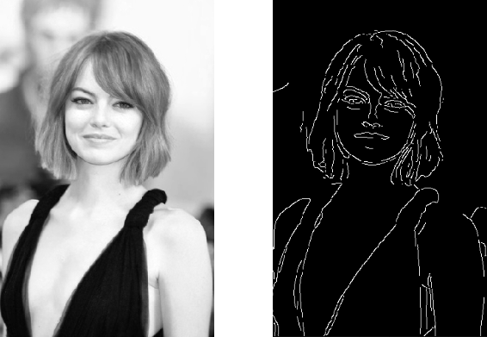
Edge Detection
Edge detection includes a variety of mathematical methods that aim at identifying edges, curves in a digital image at which the image brightness changes sharply or, more formally, has discontinuities.
Edge detection is a fundamental tool in image processing and computer vision, particularly in the areas of feature detection and feature extraction
Achieved by applying convolution operations using filters

Slide 8
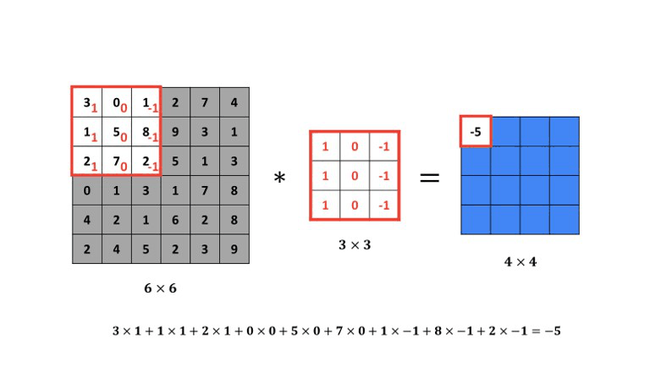
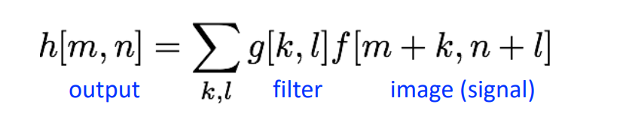
Convolution Operation using Filter

Slide 9
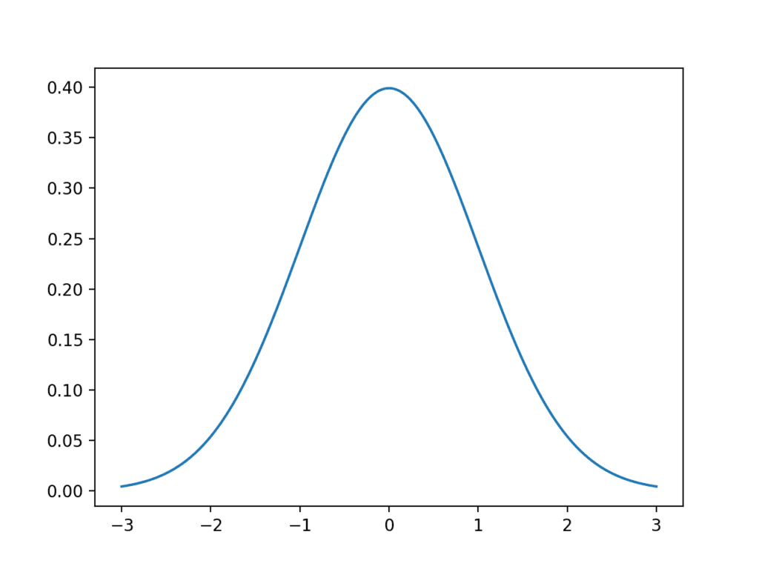
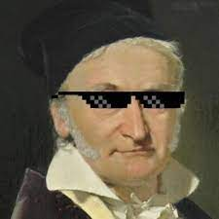
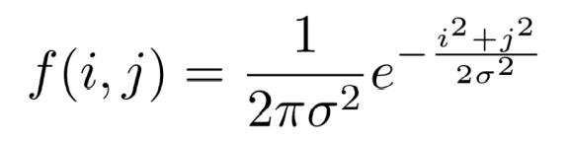
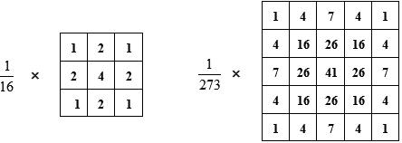
Filter Example: Gaussian Filter
Named after Carl Fredrich Gauss
Kernel values sampled from 2D Gaussian Function
The weight reduces as drift away from the center pixel
Used for reducing noise in an image or for smoothening image
Other choices of smoothening: box filter, median filter

Slide 10
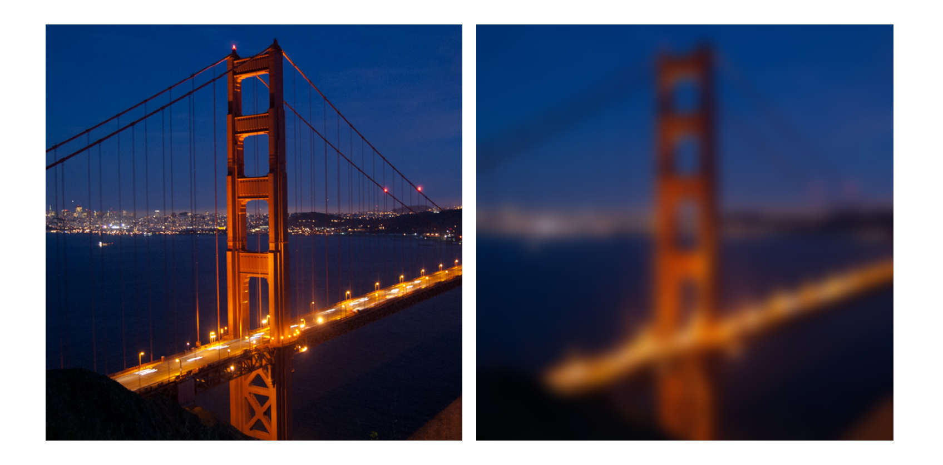
Example: Gaussian Filter Result

Slide 11
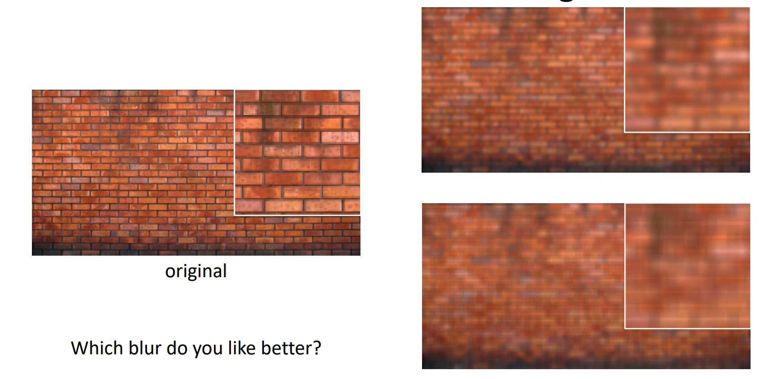
Comparison between smoothening filters

Slide 12
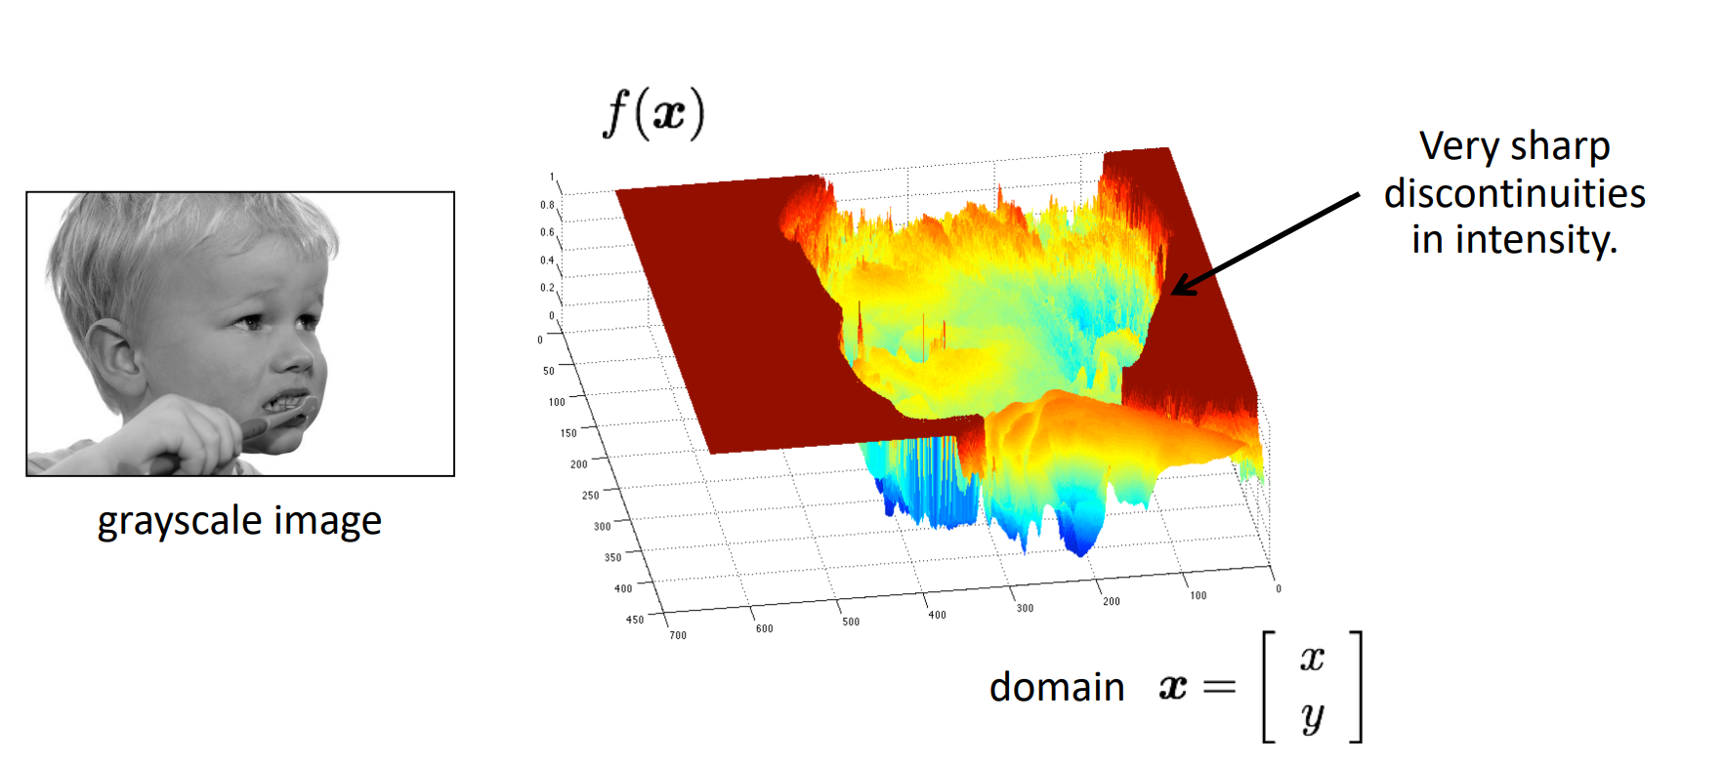
What are edges in Images ?

Slide 13

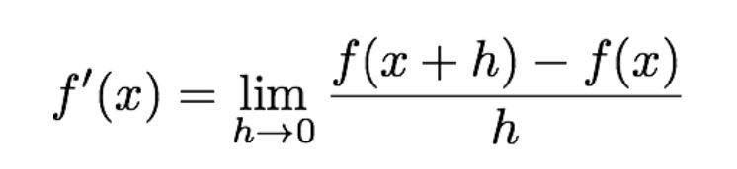
How to determine edges ?
How do you detect edges/How do you calculate discontinuities in a function ?
Ans: You take derivatives, as derivatives are large at discontinuities. Since it’s a 2D function we call it gradient and not derivative
The same analogy is used in Machine Learning for gradient descent
Since images are 2D discrete signals, we take finite differences

Slide 14
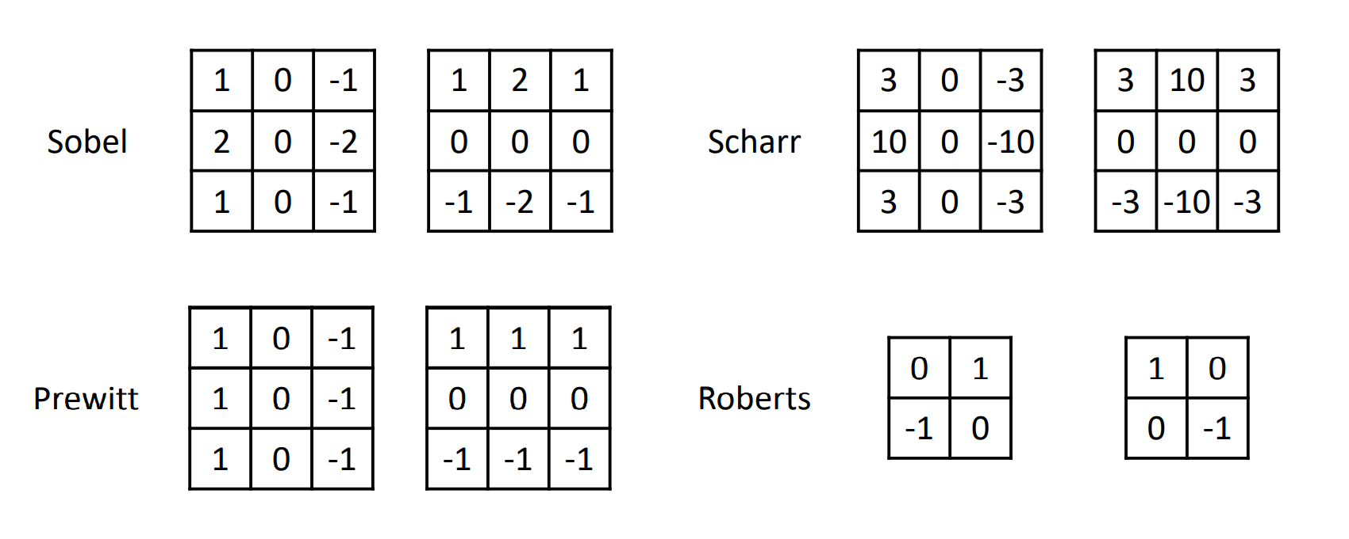
Gradient Filters

Slide 15
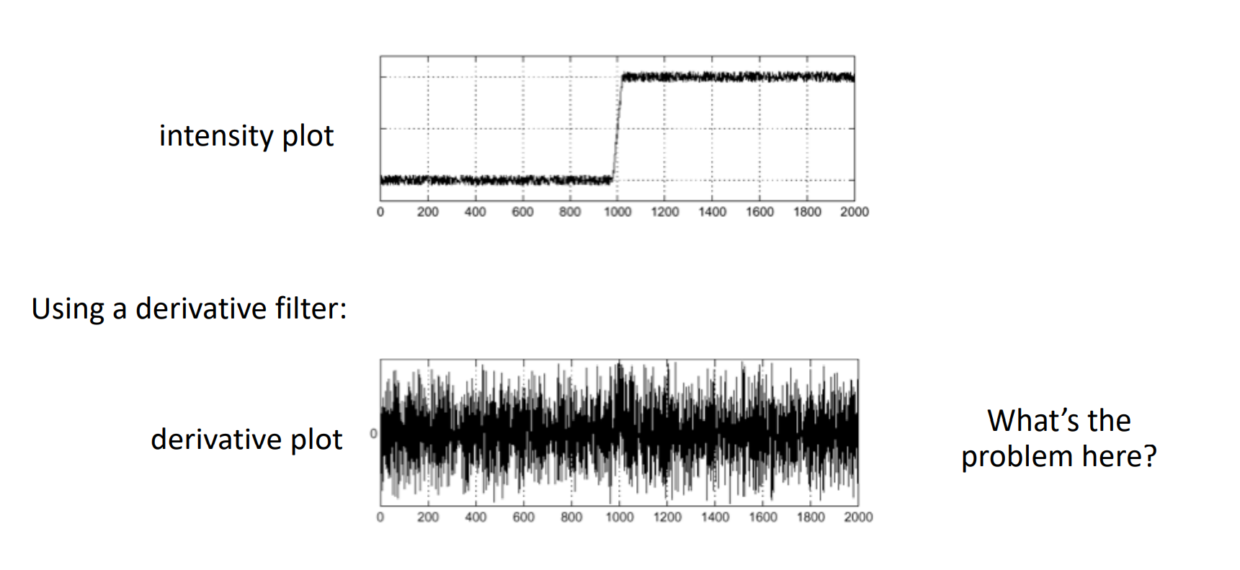
Differentiation of a 1D Signal

Slide 16
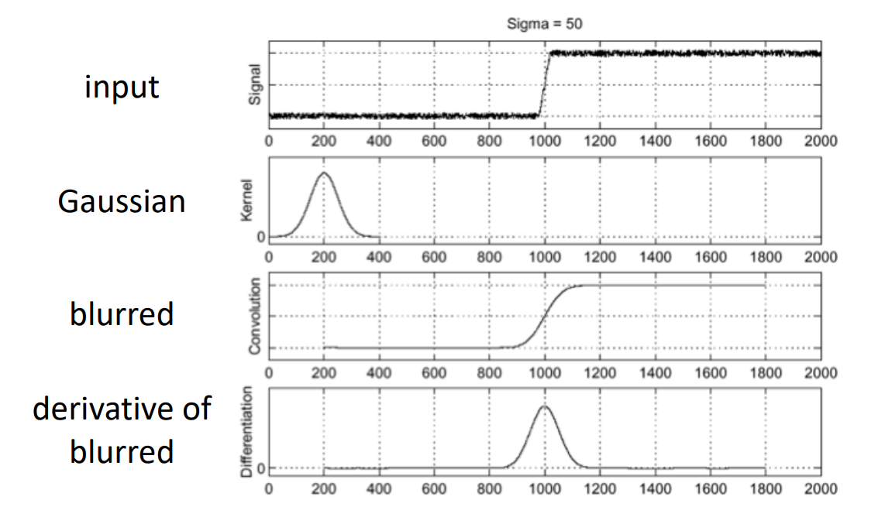
Derivatives/Gradient are sensitive to noise

Slide 17
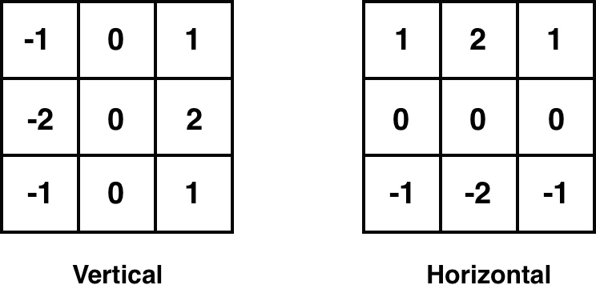
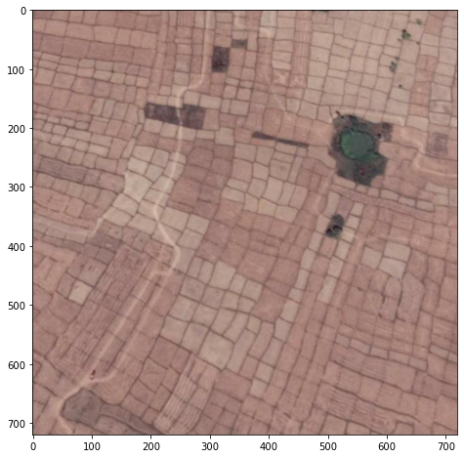
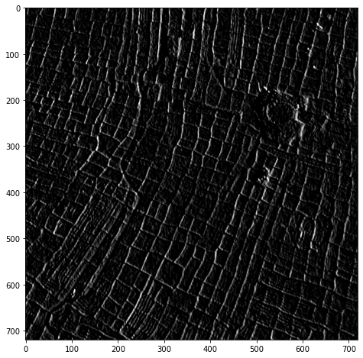
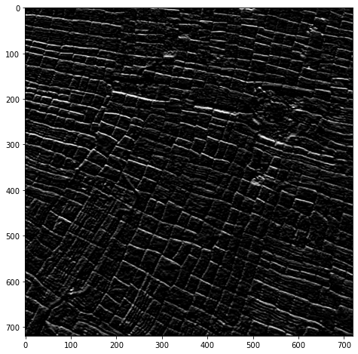
Sobel Filter Example

Slide 18
Canny Edge Detection
Convert Image to Grayscale
Gaussian Blur
Removes noise from the image
Determine the Gradients
Both horizontal and vertical gradient filters applied and magnitude is calculated to detect pixel intensity changes
Non Maximum Suppression
Image magnitude in the previous step results in thick edges, the final image should have thin edges
Perform a suppression based on comparison of neighbouring pixel values
https://docs.opencv.org/4.x/da/d22/tutorial_py_canny.html

Slide 19
Canny Edge Detection
5. Double Thresholding
Result from NMS is not perfect, some edges may not be edges and there is some noise present in the image
Two thresholds are maintained: low thresh and high thresh e.g. 50 and 150
Areas with pixel values which are less than low thresh are declared as non edges and are set to 0
Areas with pixel values which are greater than high thresh are declared as strong edges and are set to 255
Areas with pixel value between low and high thresh are declared as weak edges and are dealt with in step 6
6. Edge Tracking by Hysteresis
Weak edges which are connected to strong edges will be actual edges
Weak edges which are not connected to strong edges are removed
https://docs.opencv.org/4.x/da/d22/tutorial_py_canny.html

Slide 20

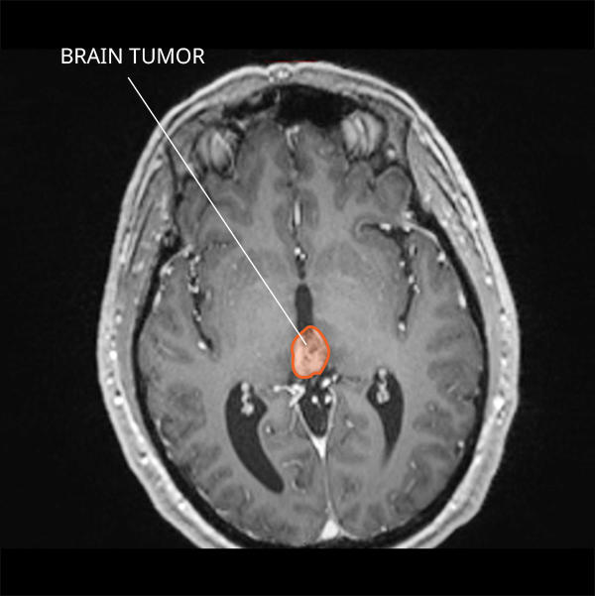
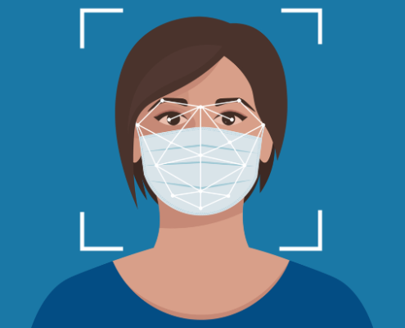
Region of Interest
A region of interest (ROI) is a portion of an image that you want to filter or operate on in some way. You can represent an ROI as a binary mask image. In the mask image, pixels that belong to the ROI are set to 1 and pixels outside the ROI are set to 0
Region of Interest pixels are denoted using 255 (all 8 binary digits set to 1)
Pixels out of ROI are denoted using 0 (all 8 binary digits set to 0)
E.g. Logo of a team on a jersey, tumor in a CT-SCAN of brain, detection of face before detecting masks, etc.

Slide 21
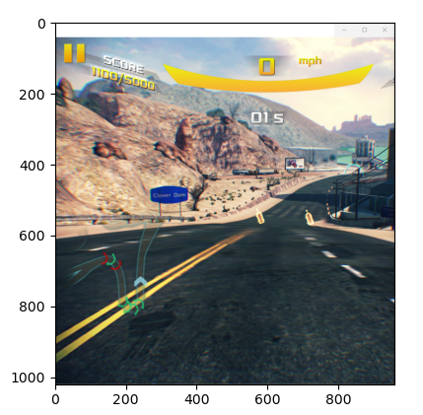
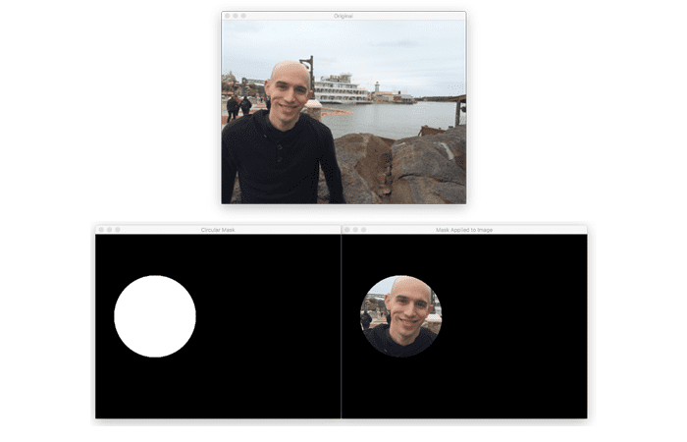
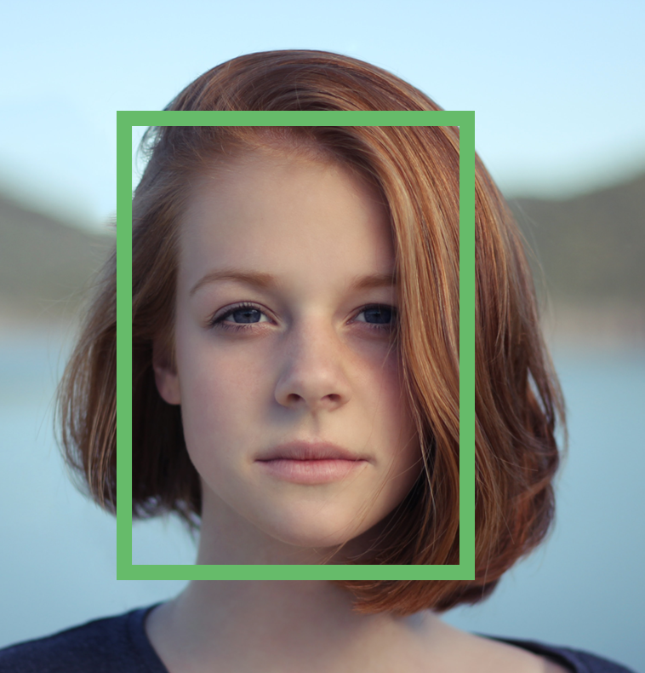

How to find your ROI ?
Determine ROI using detection algorithms
Determine ROI using contours
Determine ROI using graph coordinates
Determine ROI using Image masking

Slide 22
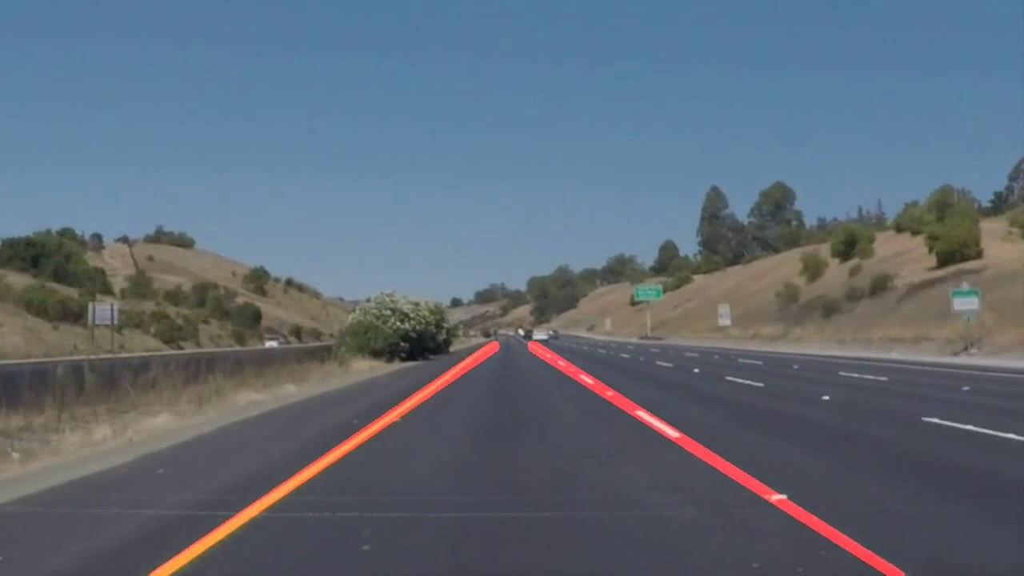
Line Detection
Line detection is an algorithm that takes a collection of n edge points and finds all the lines on which these edge points lie
The most popular line detectors are the Hough transform and convolution-based techniques.

Slide 23
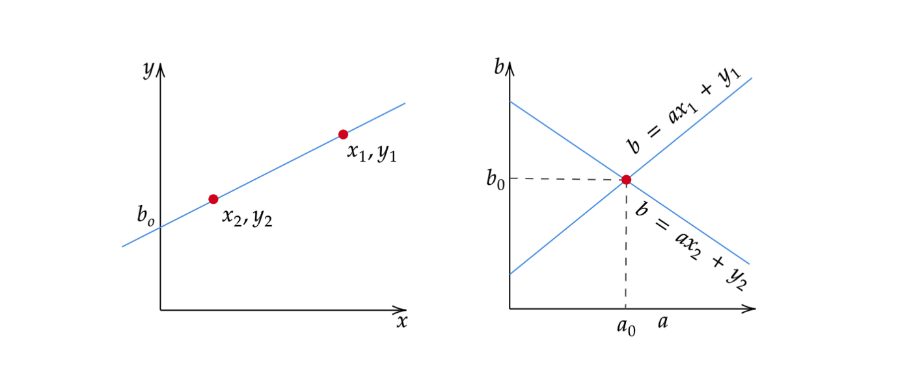
Hough Transform
Equation of a line is y = mx + c
A point in xy coordinate plane is equivalent to a line in hough space or mx coordinate space

Slide 24
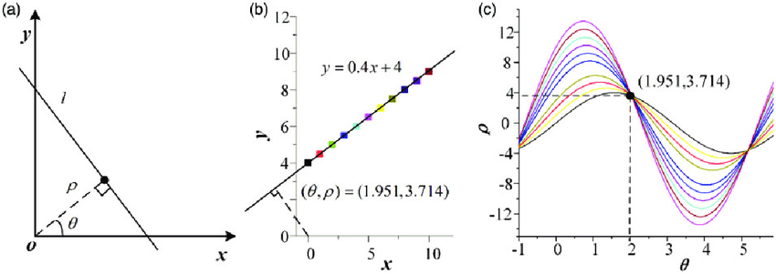
Hough Transform Contd.
Vertical Lines have slope value as infinity, therefore we instead represent the line using polar coordinates
A point in xy coordinate plane is equivalent to a line in hough space or polar coordinate space

Slide 25
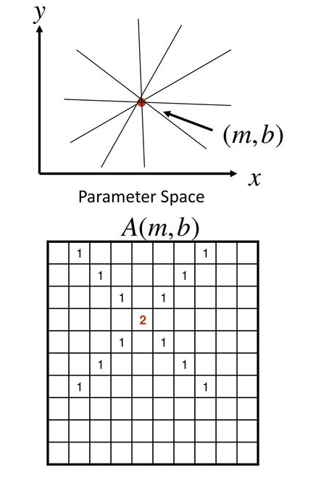
Hough Transform Line Detection Algorithm
Extract edges using Canny edge detection algorithm
Initialize parameter space p and theta using a 2D array (referred to as accumulator array)
Initialize all the values in the accumulator array to zero
For each edge pixel
For each value of theta
Calc p = xcos(theta) + ysin(theta)
Increment the value in Accumulator array A at A(p,theta)
Find the max value in Accumulator array A, these will be the parameters p and theta for your line.
Note: Sometimes they are converted back into m and b parameter space in opencv implementations

Slide 26
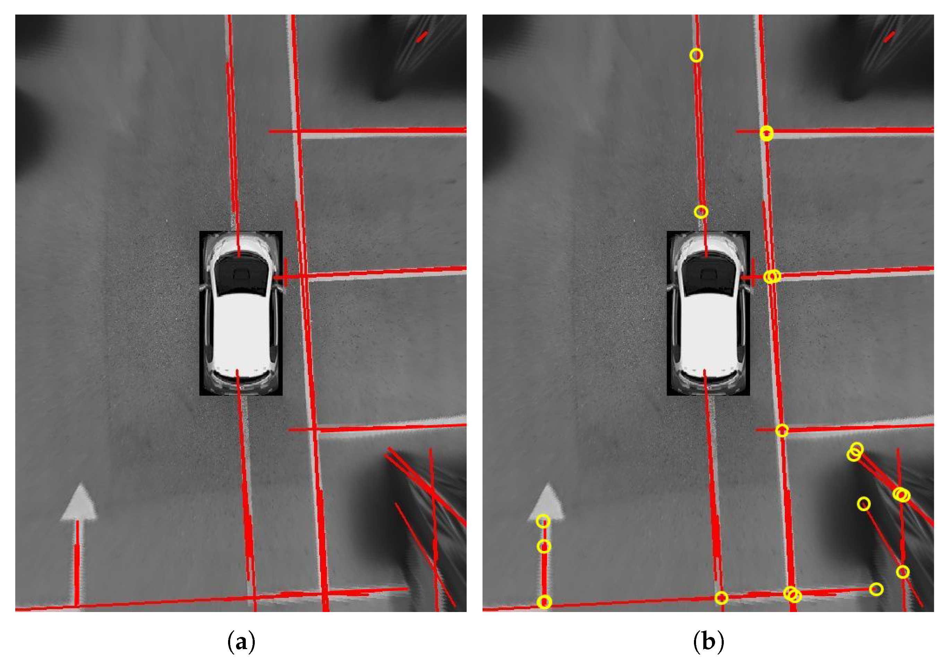
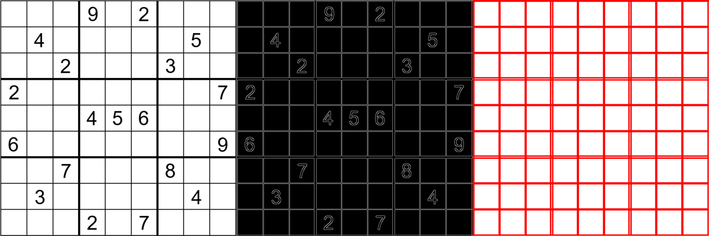
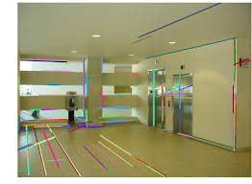
Some other Applications of Line Detection

Slide 27
Classroom Doubts
Why do we use line detection followed by edge detection ?
Since the edges detected using canny edge detection are of different types (horizontal, vertical, diagonal, wavy, etc.) to detect straight lines we apply line detection algorithm on top of the ROI (edges detected)
While averaging params do we need to keep axis=0 ?
Yes, I made an error during the classwork exercise you will have to mention axis=0 so that you get an average of both slope and intercept [w b], and not just a single average value (if you do not specify axis=0)
Why do we have to apply optimization of lines ? (reduce multiple lines into one, isn’t that what we do in Non max suppression?)
We perform non max suppression in canny edge detection to suppress thick edges into thinner consistent edges. In line detection multiple lines may get detected depending on the presence of edge pixels present, therefore we perform parameters averaging to reduce multiple parallel lines into one line which is represented using the average parameters.

Slide 28
Thank you
For any queries drop an email at: quadeershaikh15.8@gmail.com

